Slide 1

Library Management System.
Group Members :-
Adwait Deshmukh
Sangram Deshmukh
Sujeet Jawale
Guide Name: Dr. Manjiri Ranjanikar
Department of Computer Engineering PCET’s Pimpri Chinchwad College of Engineering

Slide 2
Contents
Introduction
Objectives
Motivation
Proposed Architecture
Implementation Screenshot
Conclustion

Slide 3
Introduction
It is used by librarian to manage the library using a computerized system where he/she can record various transactions like issue of books, return of books, addition of new books, addition of new students etc.
Books and student maintenance modules are also included in this system which would keep track of the students using the restaurant and also a detailed description about the books a Library contains.
With this computerized system there will be no loss of book record or member record which generally happens when a non-computerized system is used.
In addition, report module is also included in Library Management System.
If user’s position is admin, the user is able to generate different kinds of reports like lists of students registered, list of books, issue and return reports.
All these modules are able to help librarian to manage the Library with more convenience and in a more efficient way as compared to Library systems which are not computerized

Slide 4
Objective
The project objectives that will be achieved after completion of this project are discussed in this
subchapter. The objectives are as follows:
Online book issue
Request column for librarian for providing new books
Student login page where students can find books issued by him/her and date of return.
Admin should be able to add librarian and remove librarian. Admin have all the privileges.
Librarians can add the books, can issue books to students and also can enter returning details at the time of returning into it

Slide 5
Motivation
The system helps both students and library manager to keep a constant track of all the books available in the library. It allows both the admin and the student to search for the desired book.
It becomes necessary for colleges to keep a continuous check on the books issued and returned and even calculate fine. This task if carried out manually will be tedious and includes chances of mistakes. These errors are avoided by allowing the system to keep track of information such as issue date, last date to return the book and even fine information and thus there is no need to keep manual track of this information which thereby avoids chances of mistakes

Slide 6
Functional Requirement
LIBRARIAN LOGIN:
Description: Provides login to the librarian for the purpose of the security. Functional Requirement: This feature used by the user to login into system. They are required to enter user id and password before they are allowed to enter the system. The user id and password will be verified and if invalid id is there user is allowed to not enter the system.
REGISTER NEW BOOK:
Description: This feature allows to add new book in the library. Functional requirements: System must be able to verify information. System must be able to not allow two books having same book.
VIEW BOOKS:
Description: This feature is found in book maintenance part. we can search book based on book id, book name, publication or by author name. Functional requirements System must be able to search the database based on select search type - System must be able to show the book in table view.

Slide 7
Non-Functional Requirement
REQUIREMENT : When a library management system will be implemented librarian can easily access library as searching and book transaction will be very faster.
RELIABILITY REQUIREMENT : The system should accurately perform the list generation, book transaction and database maintenance.
USABILITY REQUIREMENT : The system is designed for a user-friendly environment so librarian can perform the various tasks easily and in an effective way

Slide 8
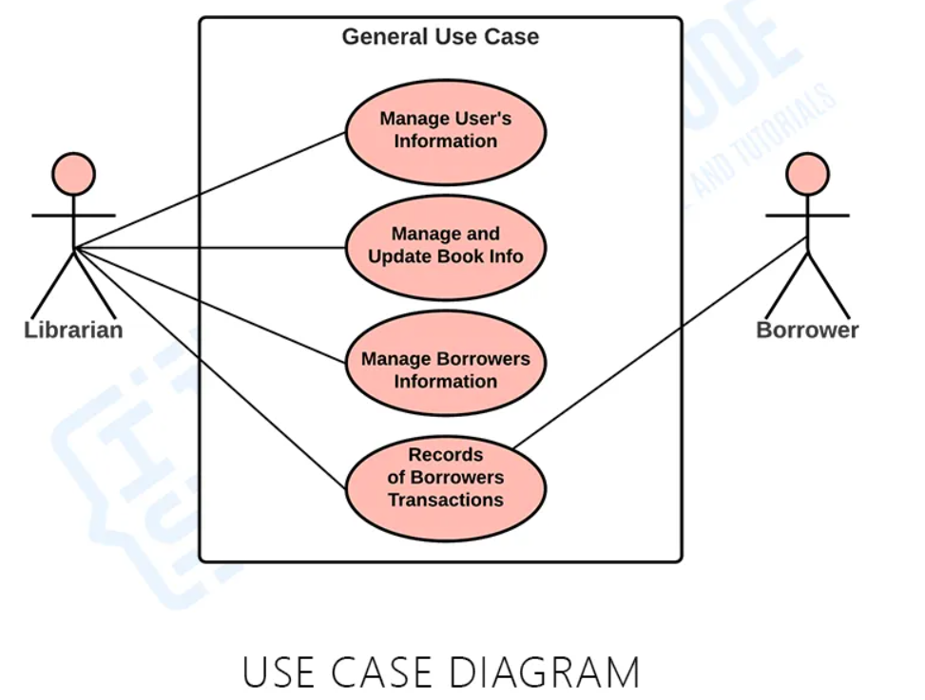
Use Case Diagram

Slide 9
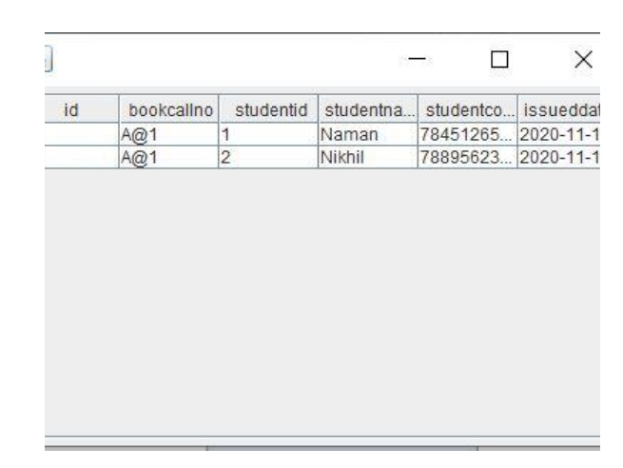
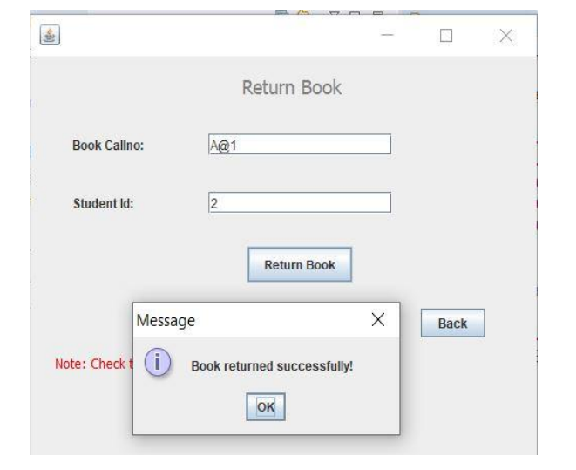
Implementation Screenshot

Slide 10
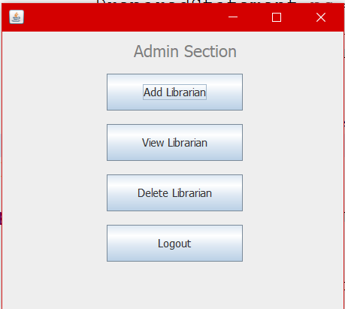
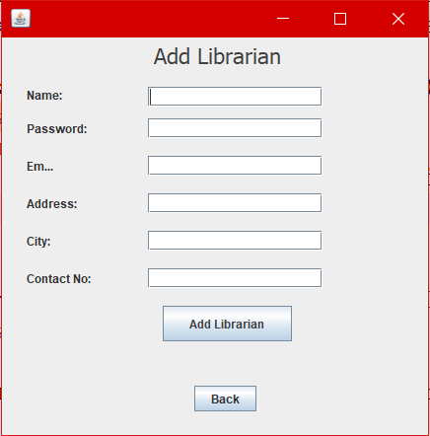
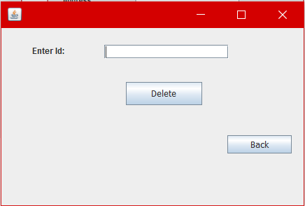
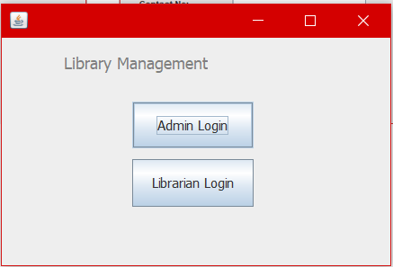
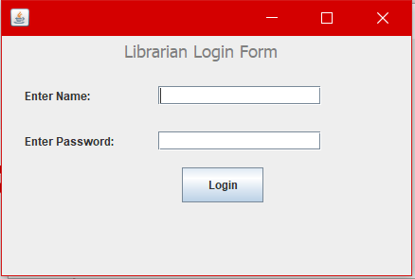
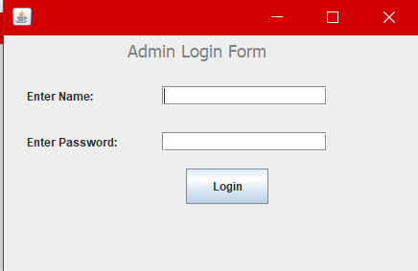

Slide 11
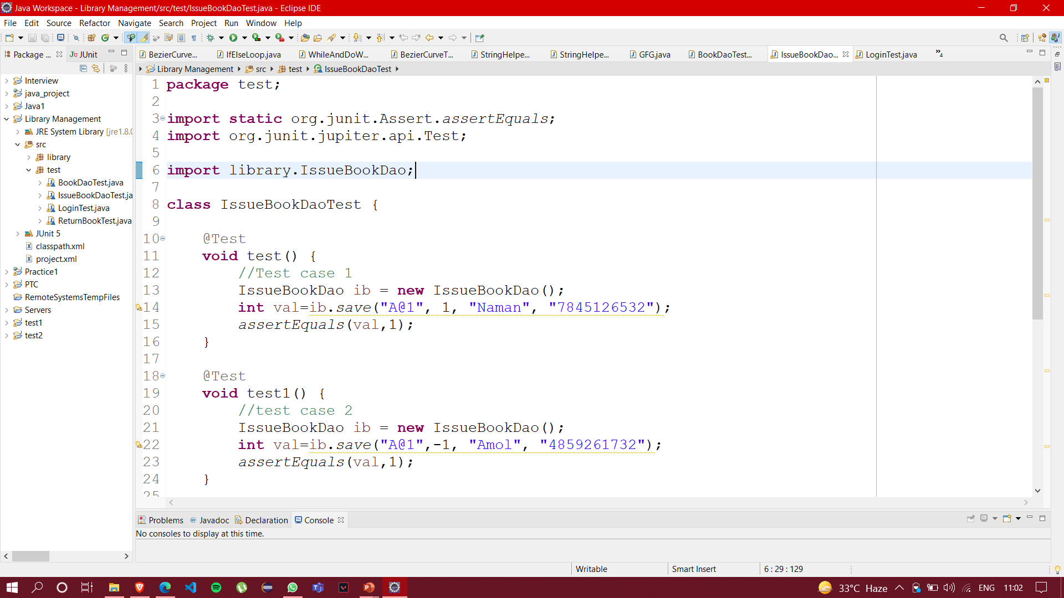
ISSUEBOOKDAOTEST

Slide 12
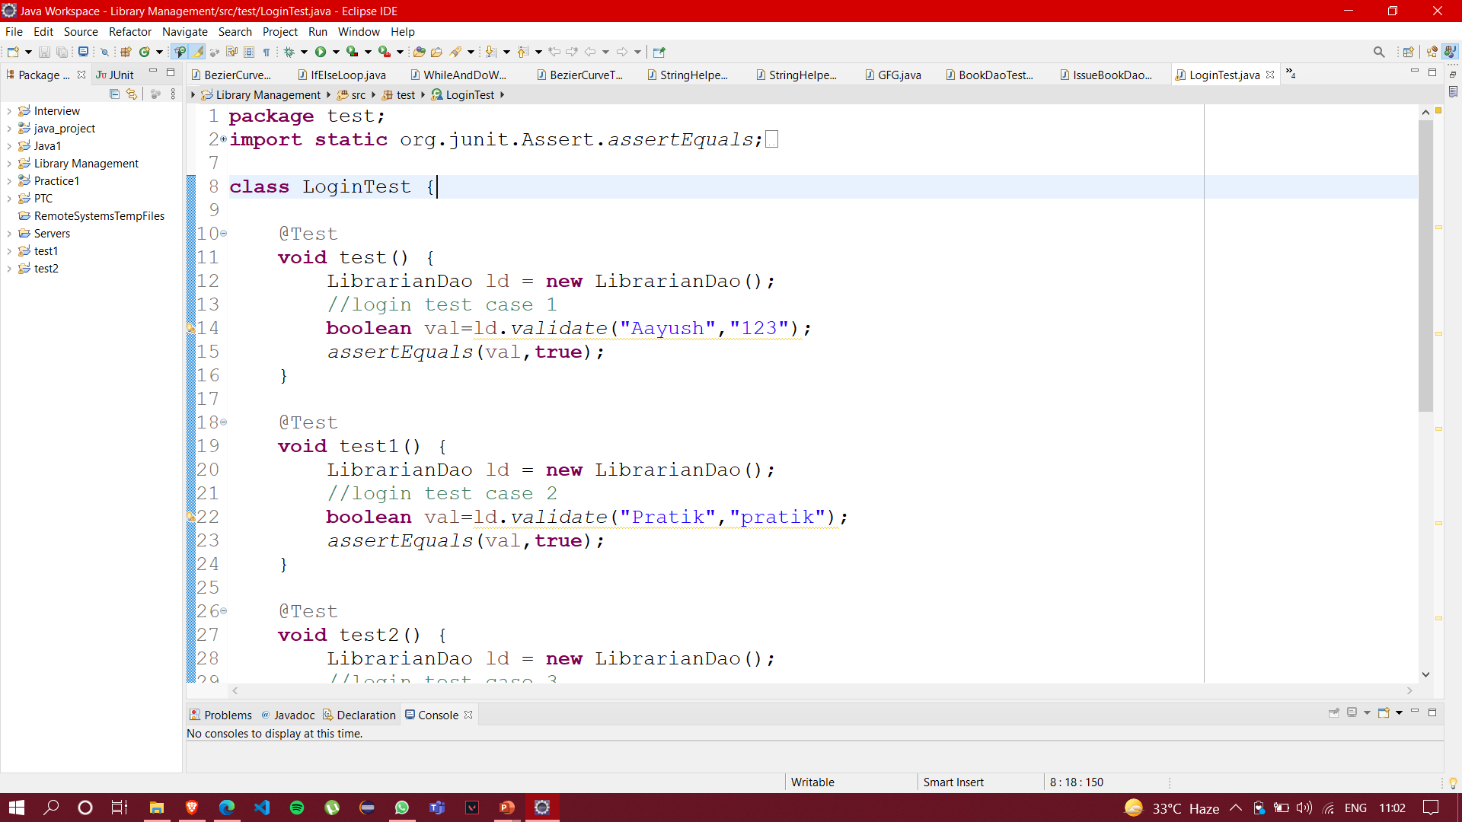
LOGINTEST

Slide 13
THANKYOU

